Slide 1
COVID 2020 Survey Responses Region 3

Slide 2
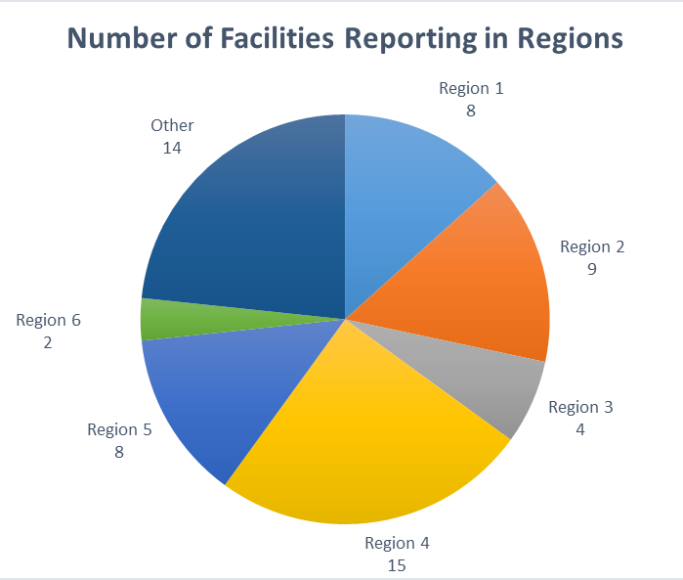
Quick Facts:
60 Respondents
14 Out of State
COVID Sucks – MUST WATCH
MAP - https://tinyurl.com/Map-COVID

Slide 3
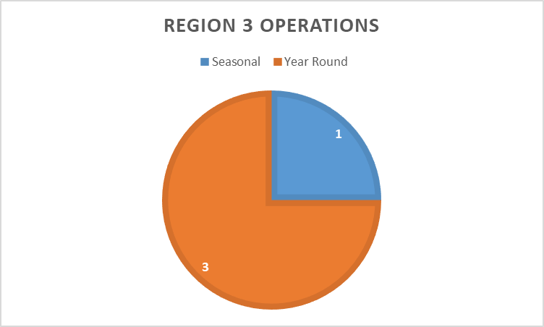
Region 3 Operations:

Slide 4
Region 3 Closure Dates:
 | Closure | Opening Day?
Blue Bell Aquatics Center | 3/15/2020 | unknown
City of Conroe Aquatic Center | 3/20/2020 | Unknown
Texas A&M Recreational Sports | 3/19/2020 | May 1st
Bryan Aquatic Center | 3/23/2020 | Currently 5/4 for our year round facility until we're told otherwise and 5/23 for our seasonal pools

Slide 5
Region 3 School Opening Est:
Facility Name | Est. School District Opening
Blue Bell Aquatics Center | 5/5/2020
City of Conroe Aquatic Center | 5/4/2020
Texas A&M Recreational Sports | Unreported
Bryan Aquatic Center | 5/4/2020

Slide 6
Region 1 & 2 Cancellations & Purchasing:
Facility Name | Purchasing Limits? | Cancellations
Blue Bell Aquatics Center | Yes | movies, swim lessons, aquatic therapy, pool operations in general
City of Conroe Aquatic Center | No | Learn to swim, Water Aerobics, US Swim program, Diving, Lifeguard class, WSI class
Texas A&M Recreational Sports | No | Aggieland Long Course, Texas Senior Circuit, Learn-to-Swim, Lifeguard Courses
Bryan Aquatic Center | No | Spring Swim Lessons, Swim Team Practices, SCUBA, April Pool's Day Water Safety Event, Lifeguard classes, WSI/LGI classes, staff training.

Slide 7
Region 3 Staffing:
Facility Name | ALL STAFF | Do you have part-tim staff working? | Full-time employee Status
Blue Bell Aquatics Center | 110 | NO - March 31 on furlough =( | 3 - Still Working
City of Conroe Aquatic Center | 110 | NO | 7 - Still Working
Texas A&M Recreational Sports | 65 | No | 43 - Still Working
Bryan Aquatic Center | 150 | Yes - 1 Pool Manager performing facility checks and routine maintenance. | None

Slide 8
Creative/Out of Box Activities:
Online pool orientation training
Social Media
Sending dryland workouts via Youtube
Online fitness classes.
Created a water safety youtube channel
Water Safety book readings
basic swim lessons content
online workouts & crafts
working with our Public Relations
Training/Staff Engagement
virtual training for returning guards including team workouts.
Kahoot quizzes.
Social Distancing in-service for staff (unpaid but with incentives for participation)
online swim instructor training
Virtual meetings and trainings
Tictok challenges
Webinars with Aquatics around the country
ZOOM meetings
Email, lifeguard questions, videos of rescues
New staff Instagram
recording orientation sessions for virtual learning
Sending staff letters – we miss you!

Slide 9
Finals Thoughts
Stay Safe
Keep Reporting
Need Specific Data?
Data points?
Other updates
Erica Peace epeace@galvestontx.gov 832-425-4196

